Slide 1
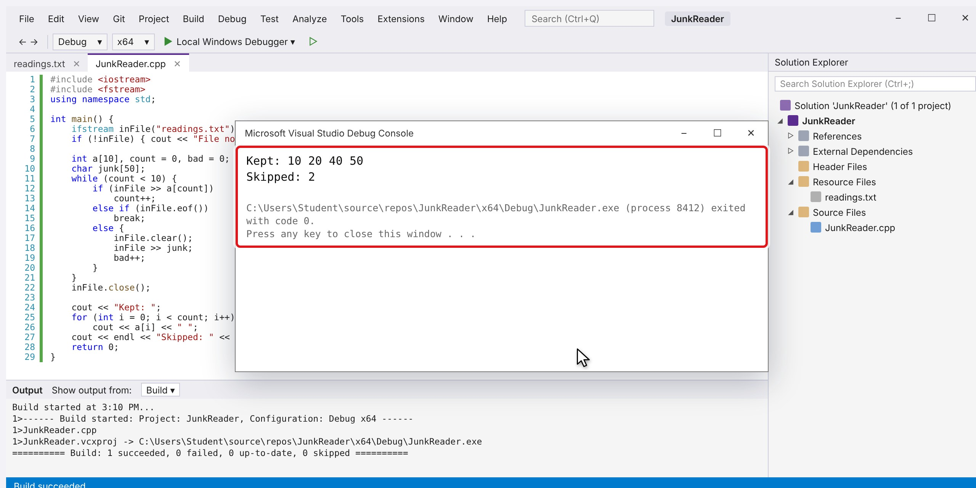
C++ FILE HANDLING · VISUAL STUDIO
Skipping junk data in Visual Studio
A file of numbers with junk words mixed in. The first program stops at the first junk word. We find out why, then fix it step by step.
The finished program keeps 10 20 40 50 and skips 2 junk words.
readings.txt 10 20 abc 40 x 50
Notes:
This deck walks through a file with junk data in Visual Studio 2022, one slide per step. Each step slide reveals the next screen and instruction on every click. The full animation video is on the last slide.

Slide 2
Eleven steps: from the error to the fix
OVERVIEW
Set up
Build and run: the error
Find and fix it
1
Create the project
4
Build the program
6
Find the error
2
Add the data file readings.txt
5
Run it: the error
7
Plan the fix
3
Write the first program
8
Fix step 1: add two variables
9
Fix step 2: replace the loop
10
Fix step 3: print the skipped count
11
Build and run again
Steps 5 and 6 (outlined) show the mistake: the first program stops at the first junk word. Steps 7 to 11 fix it.
Notes:
Use this as the map. Steps 1 to 4 set up and build the first program. Step 5 shows the wrong output on purpose, step 6 explains it, step 7 plans the fix and steps 8 to 11 make it.

Slide 3
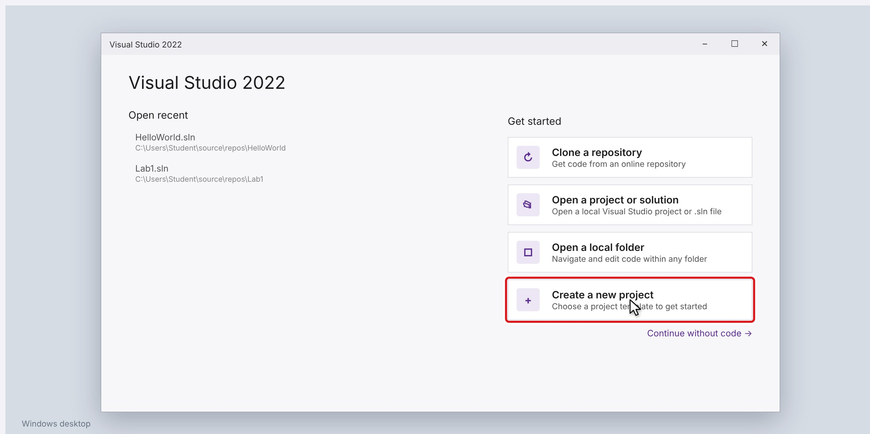
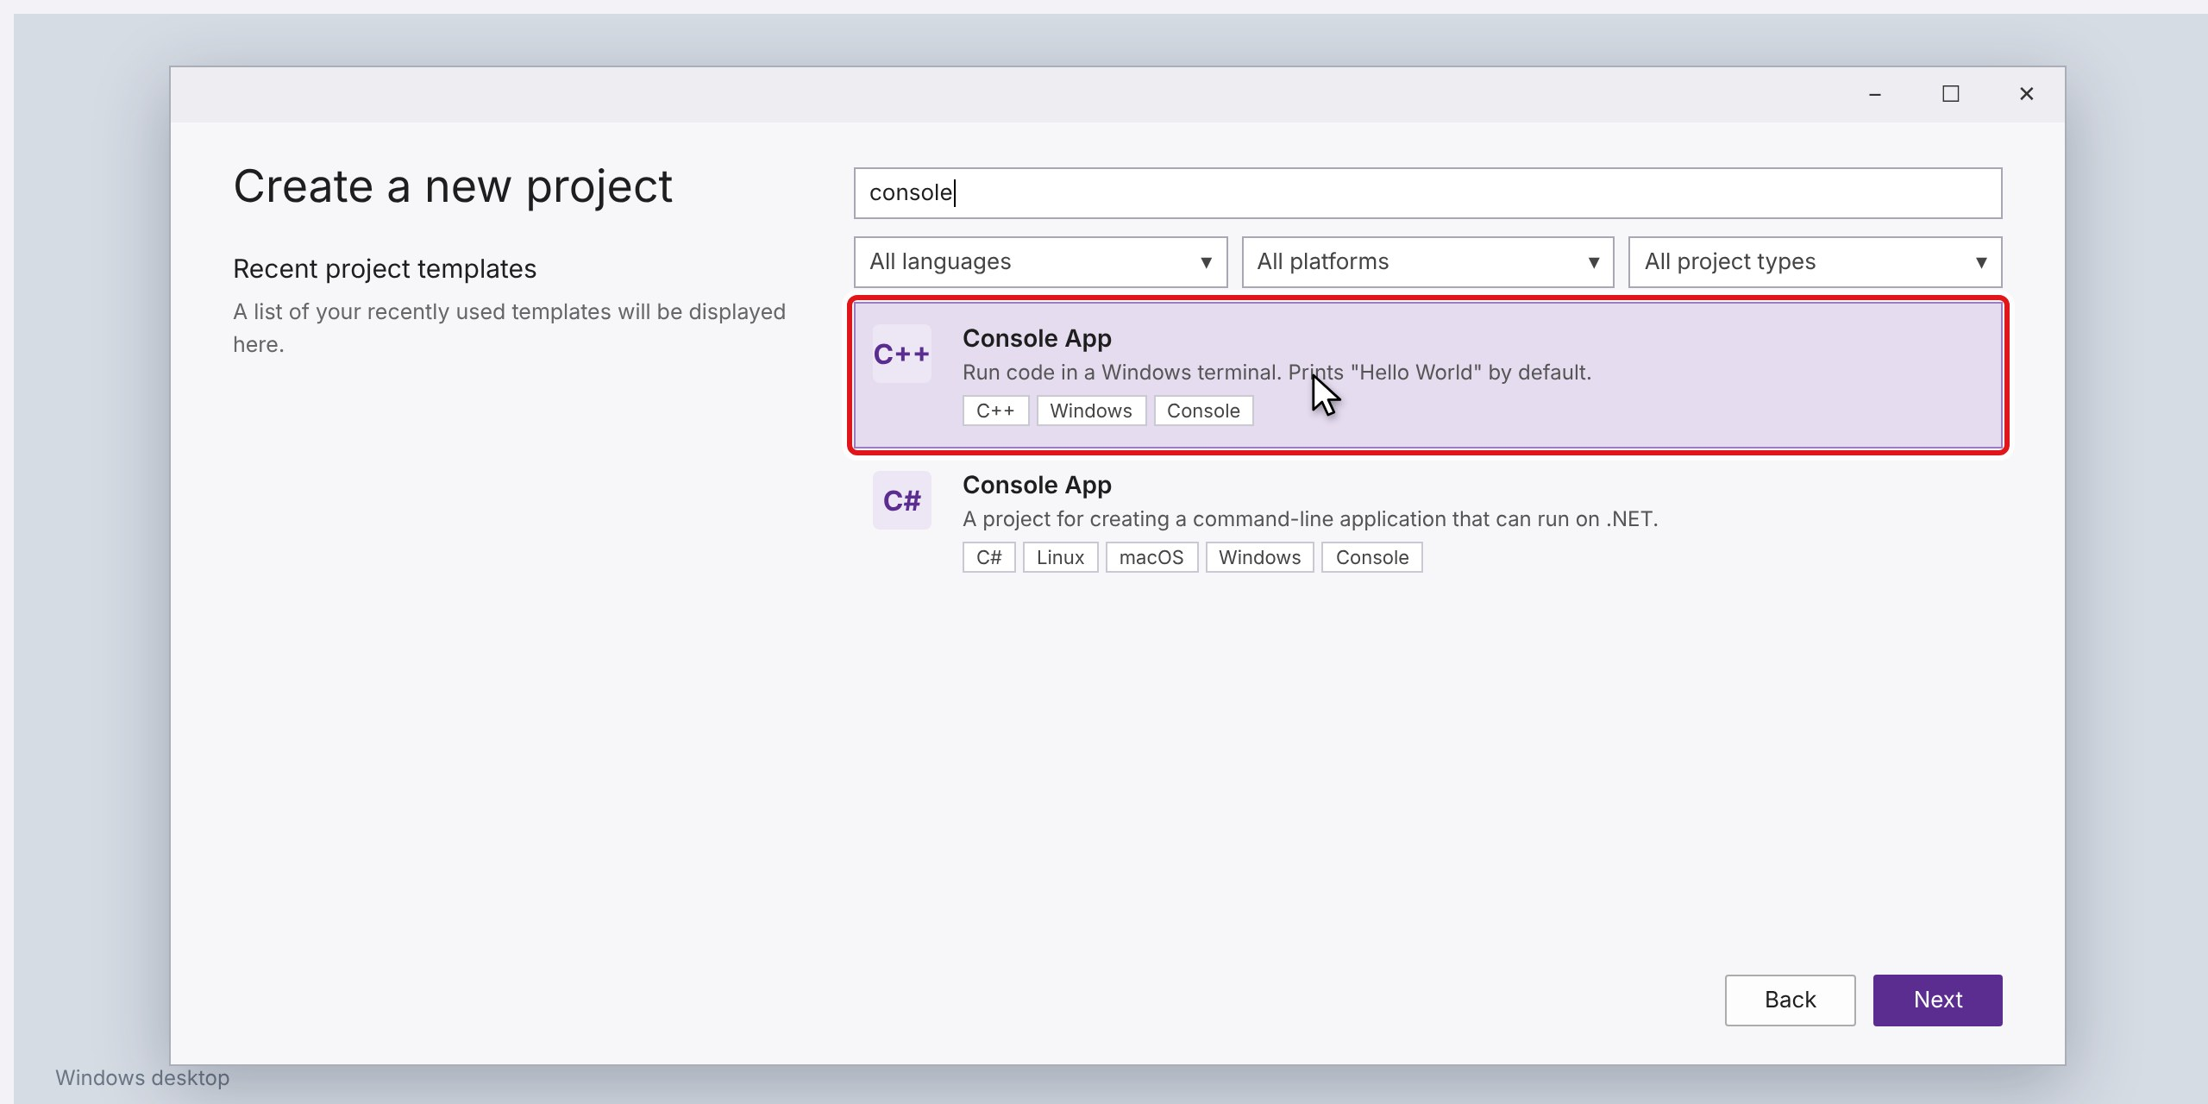
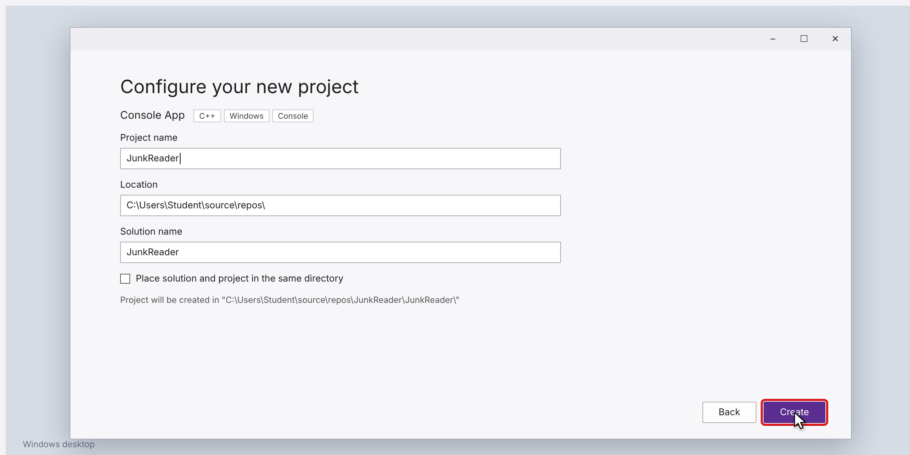
Create the project
STEP 1 OF 11
1
Start Visual Studio 2022 and click "Create a new project".
2
Search for "console" and pick Console App with the C++ tag. Click Next.
3
Name the project JunkReader and click Create.
Tip Name the project JunkReader. Visual Studio makes a folder with that name under source\repos.
Click to see the next screen
Notes:
1. Start Visual Studio 2022 and click "Create a new project".
2. Search for "console" and pick Console App with the C++ tag. Click Next.
3. Name the project JunkReader and click Create.
Tip: Name the project JunkReader. Visual Studio makes a folder with that name under source\repos.

Slide 4
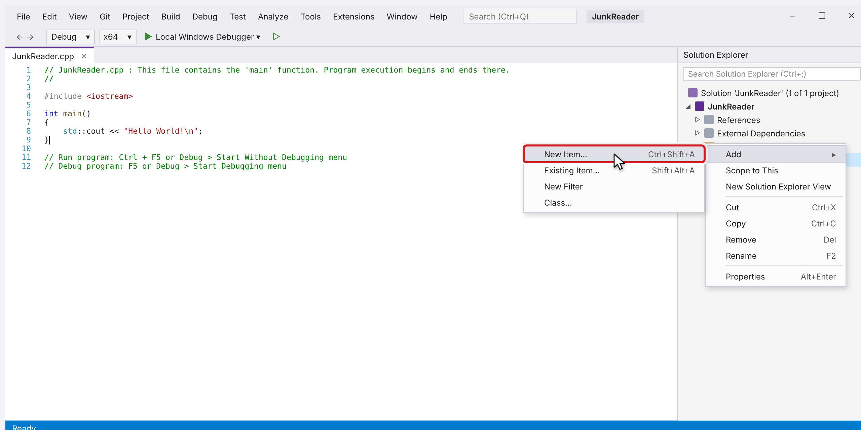
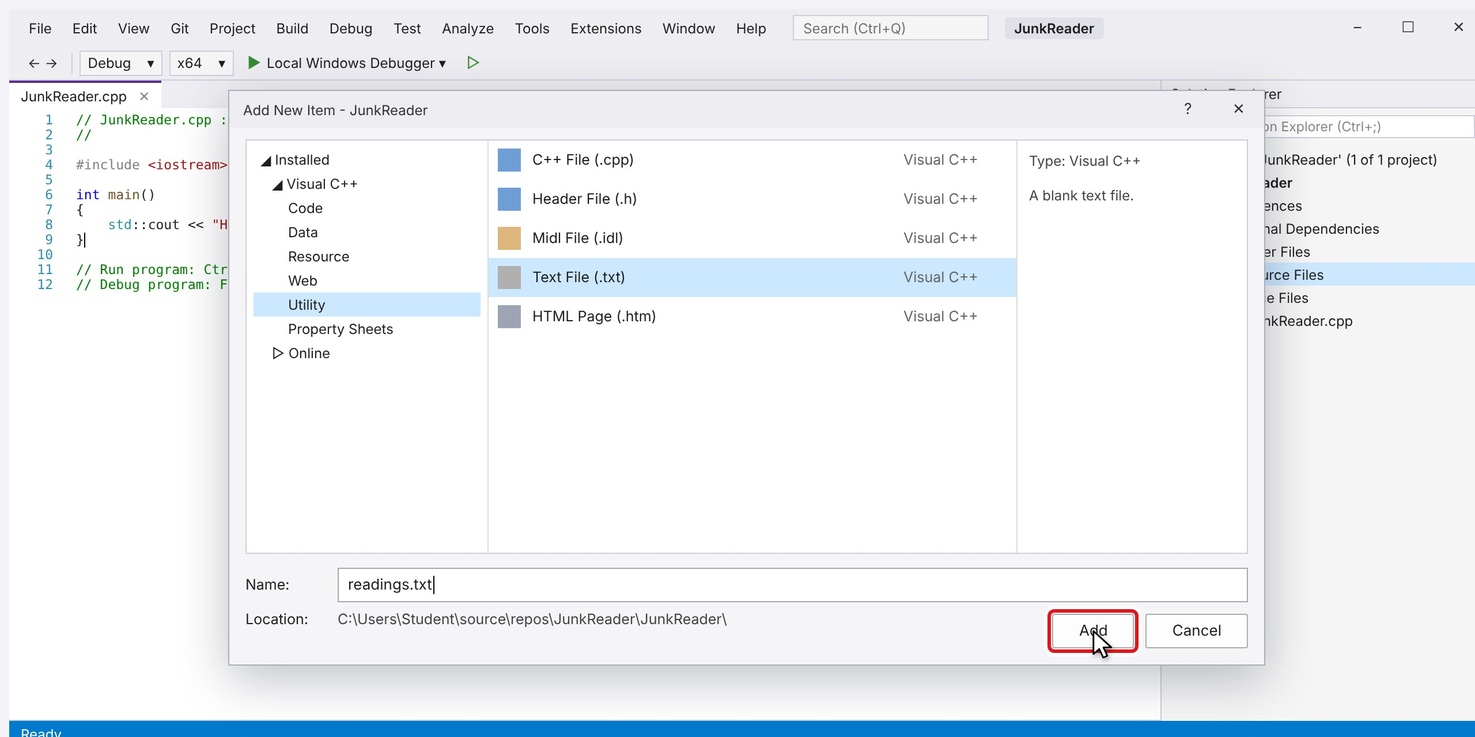
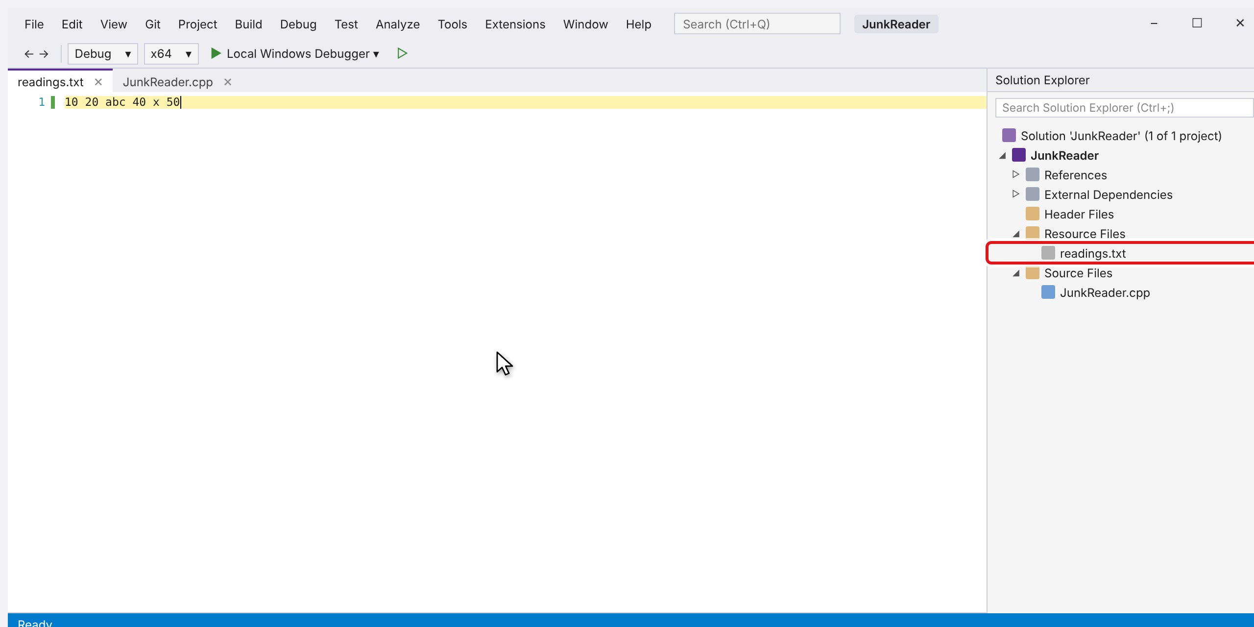
Add the data file readings.txt
STEP 2 OF 11
1
Right-click "Resource Files", then choose Add > New Item...
2
Choose Utility > Text File (.txt), name it readings.txt and click Add.
3
Type the readings. Two of them are junk: abc and x. Then press Ctrl+S to save.
Tip readings.txt must sit in the project folder, next to JunkReader.cpp. abc and x are the junk.
Click to see the next screen
Notes:
1. Right-click "Resource Files", then choose Add > New Item...
2. Choose Utility > Text File (.txt), name it readings.txt and click Add.
3. Type the readings. Two of them are junk: abc and x. Then press Ctrl+S to save.
Tip: readings.txt must sit in the project folder, next to JunkReader.cpp. abc and x are the junk.

Slide 5
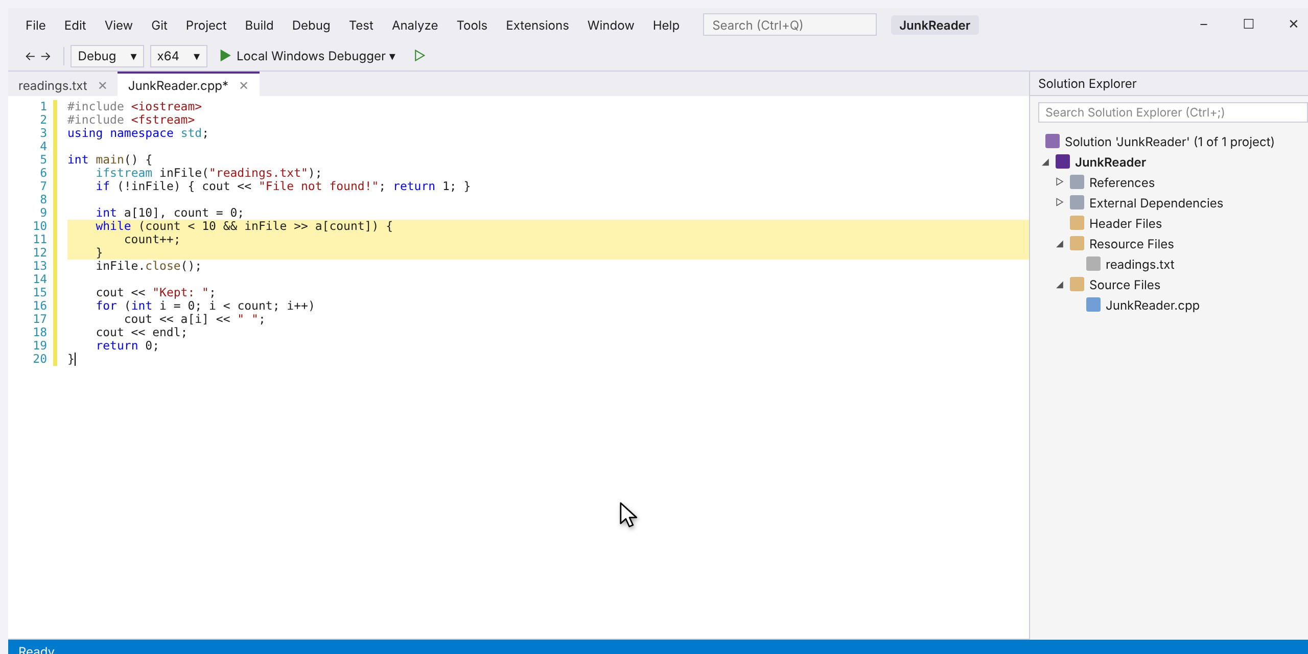
Write the first program
STEP 3 OF 11
1
The loop runs while inFile >> a[count] works. This is the same loop that worked for clean files.
Tip This is the loop from Part 1. It works for clean files, so students expect it to work here too.
Notes:
1. The loop runs while inFile >> a[count] works. This is the same loop that worked for clean files.
Tip: This is the loop from Part 1. It works for clean files, so students expect it to work here too.

Slide 6
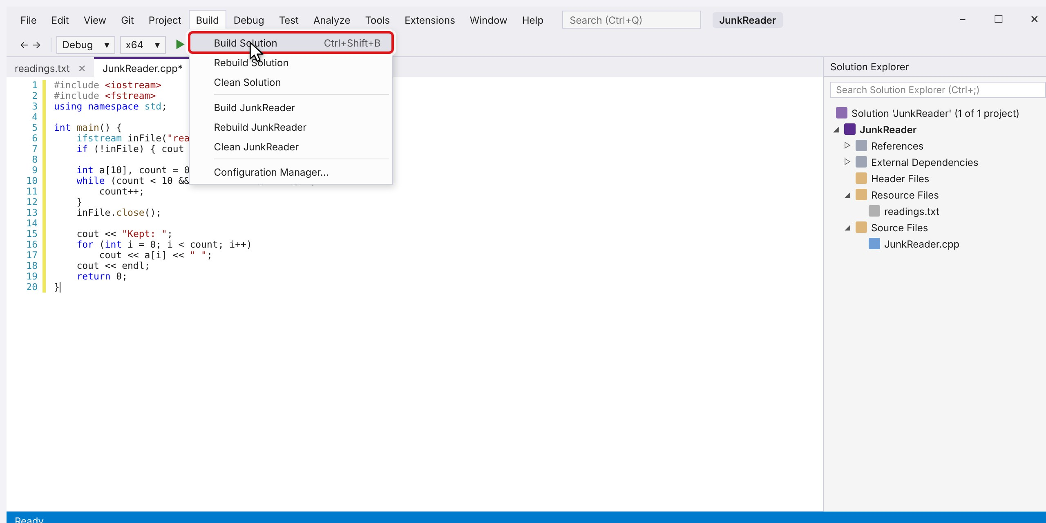
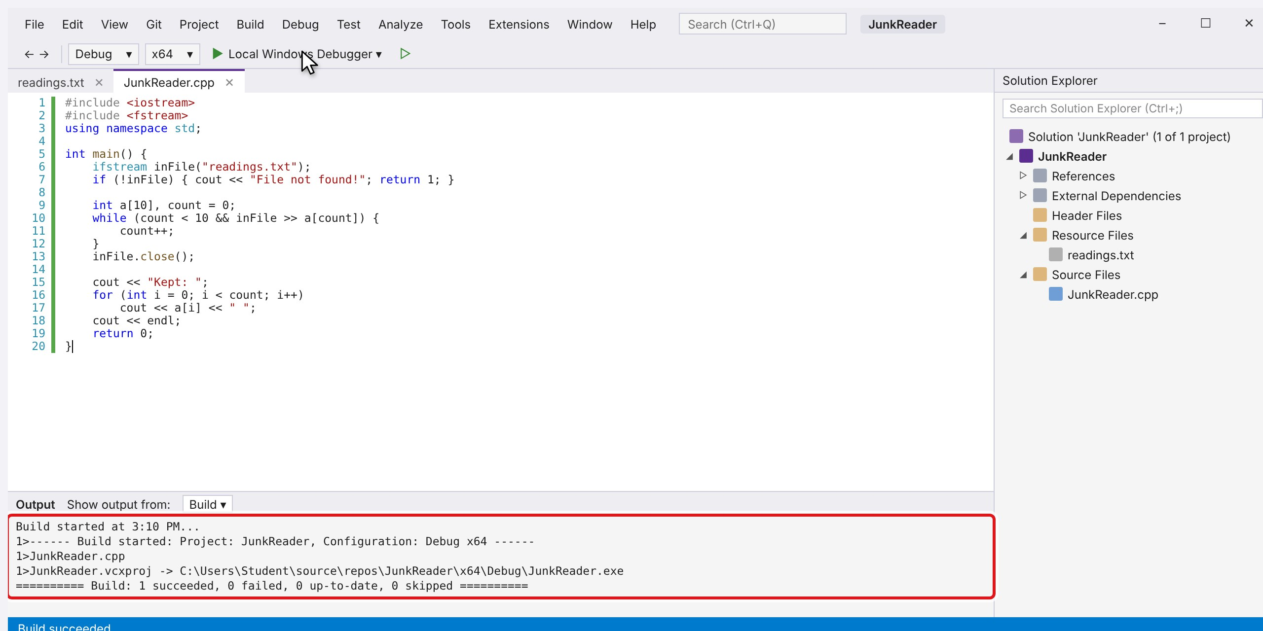
Build the program
STEP 4 OF 11
1
Open the Build menu and click Build Solution (Ctrl+Shift+B).
2
Build succeeded with 0 errors. The compiler cannot see what is inside readings.txt.
Tip The compiler checks the code, not the data. A bad file can never cause a build error.
Click to see the next screen
Notes:
1. Open the Build menu and click Build Solution (Ctrl+Shift+B).
2. Build succeeded with 0 errors. The compiler cannot see what is inside readings.txt.
Tip: The compiler checks the code, not the data. A bad file can never cause a build error.

Slide 7
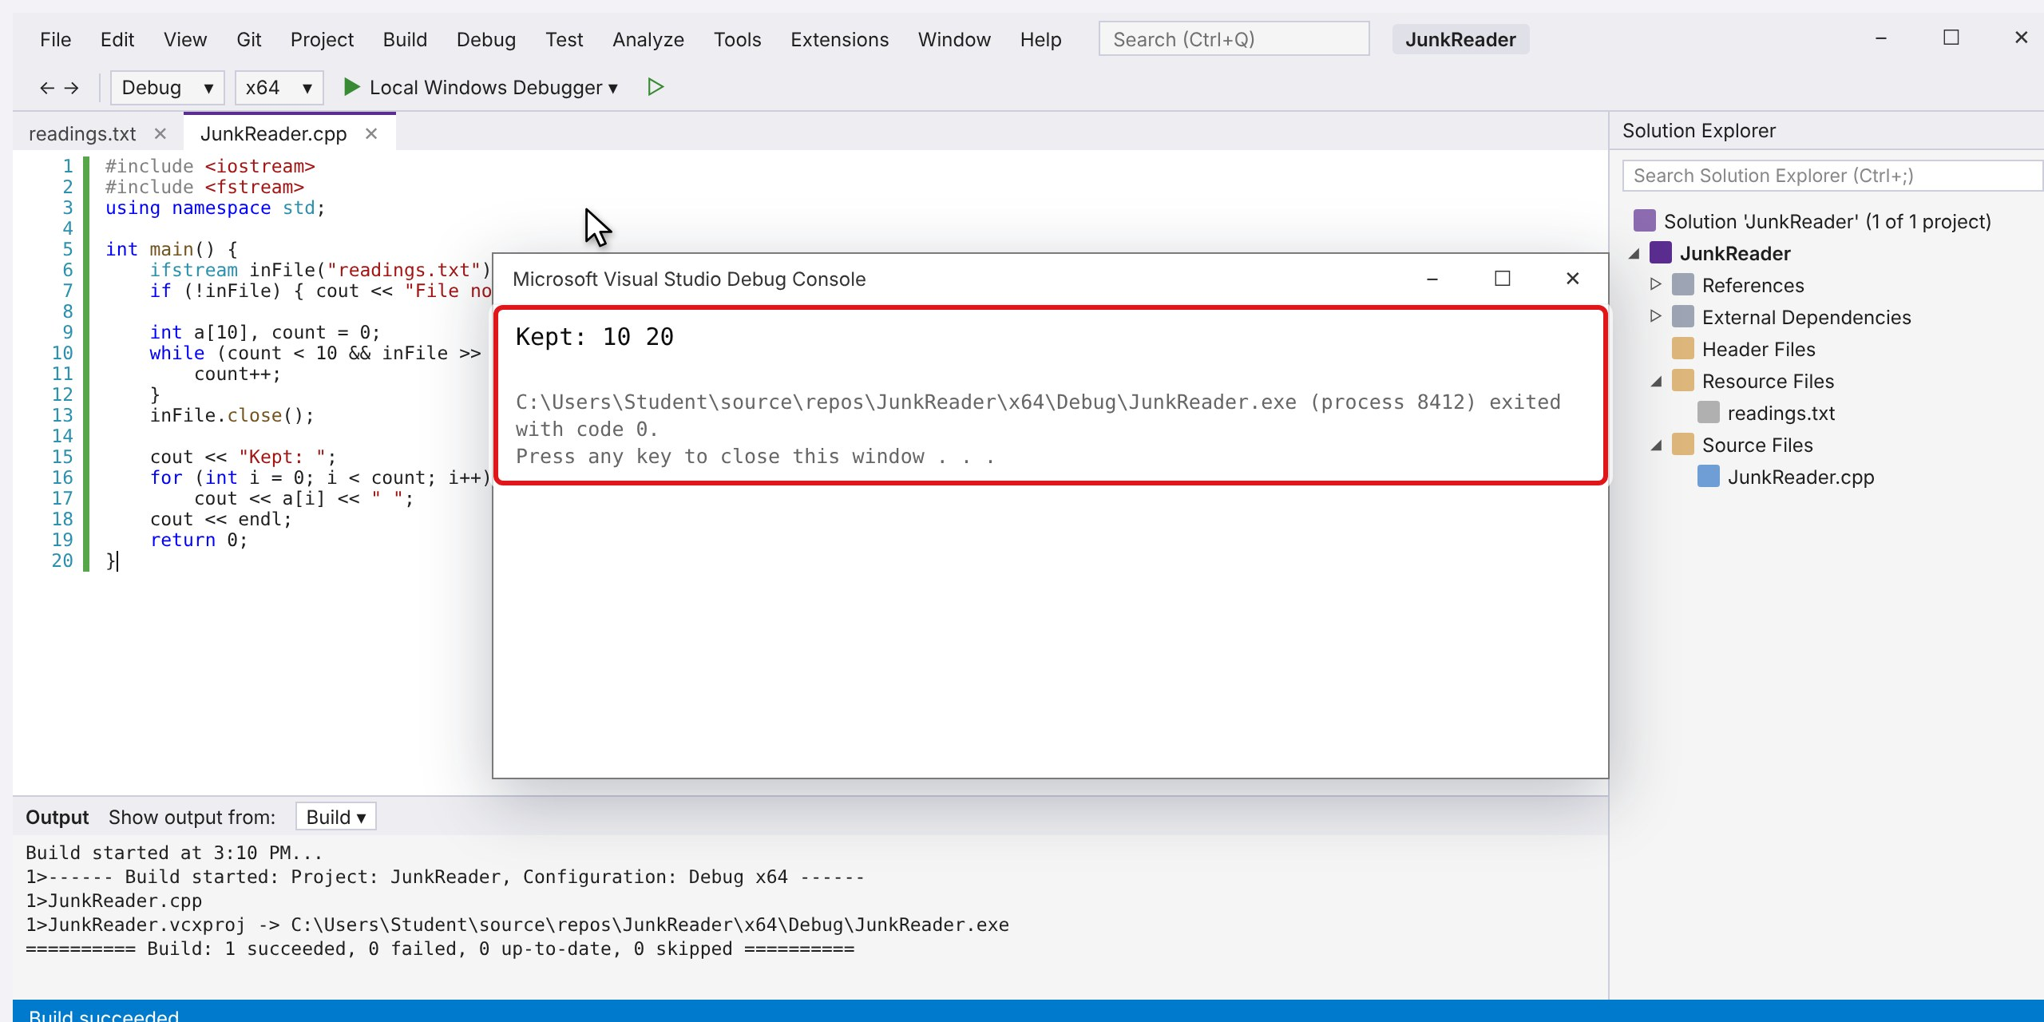
Run it: the error
STEP 5 OF 11
1
Wrong! The file has four numbers, but only 10 and 20 were kept. 40 and 50 are missing, and there is no error message.
Tip No crash and no message: the program just stops early. That is why reading errors are easy to miss.
Notes:
1. Wrong! The file has four numbers, but only 10 and 20 were kept. 40 and 50 are missing, and there is no error message.
Tip: No crash and no message: the program just stops early. That is why reading errors are easy to miss.

Slide 8
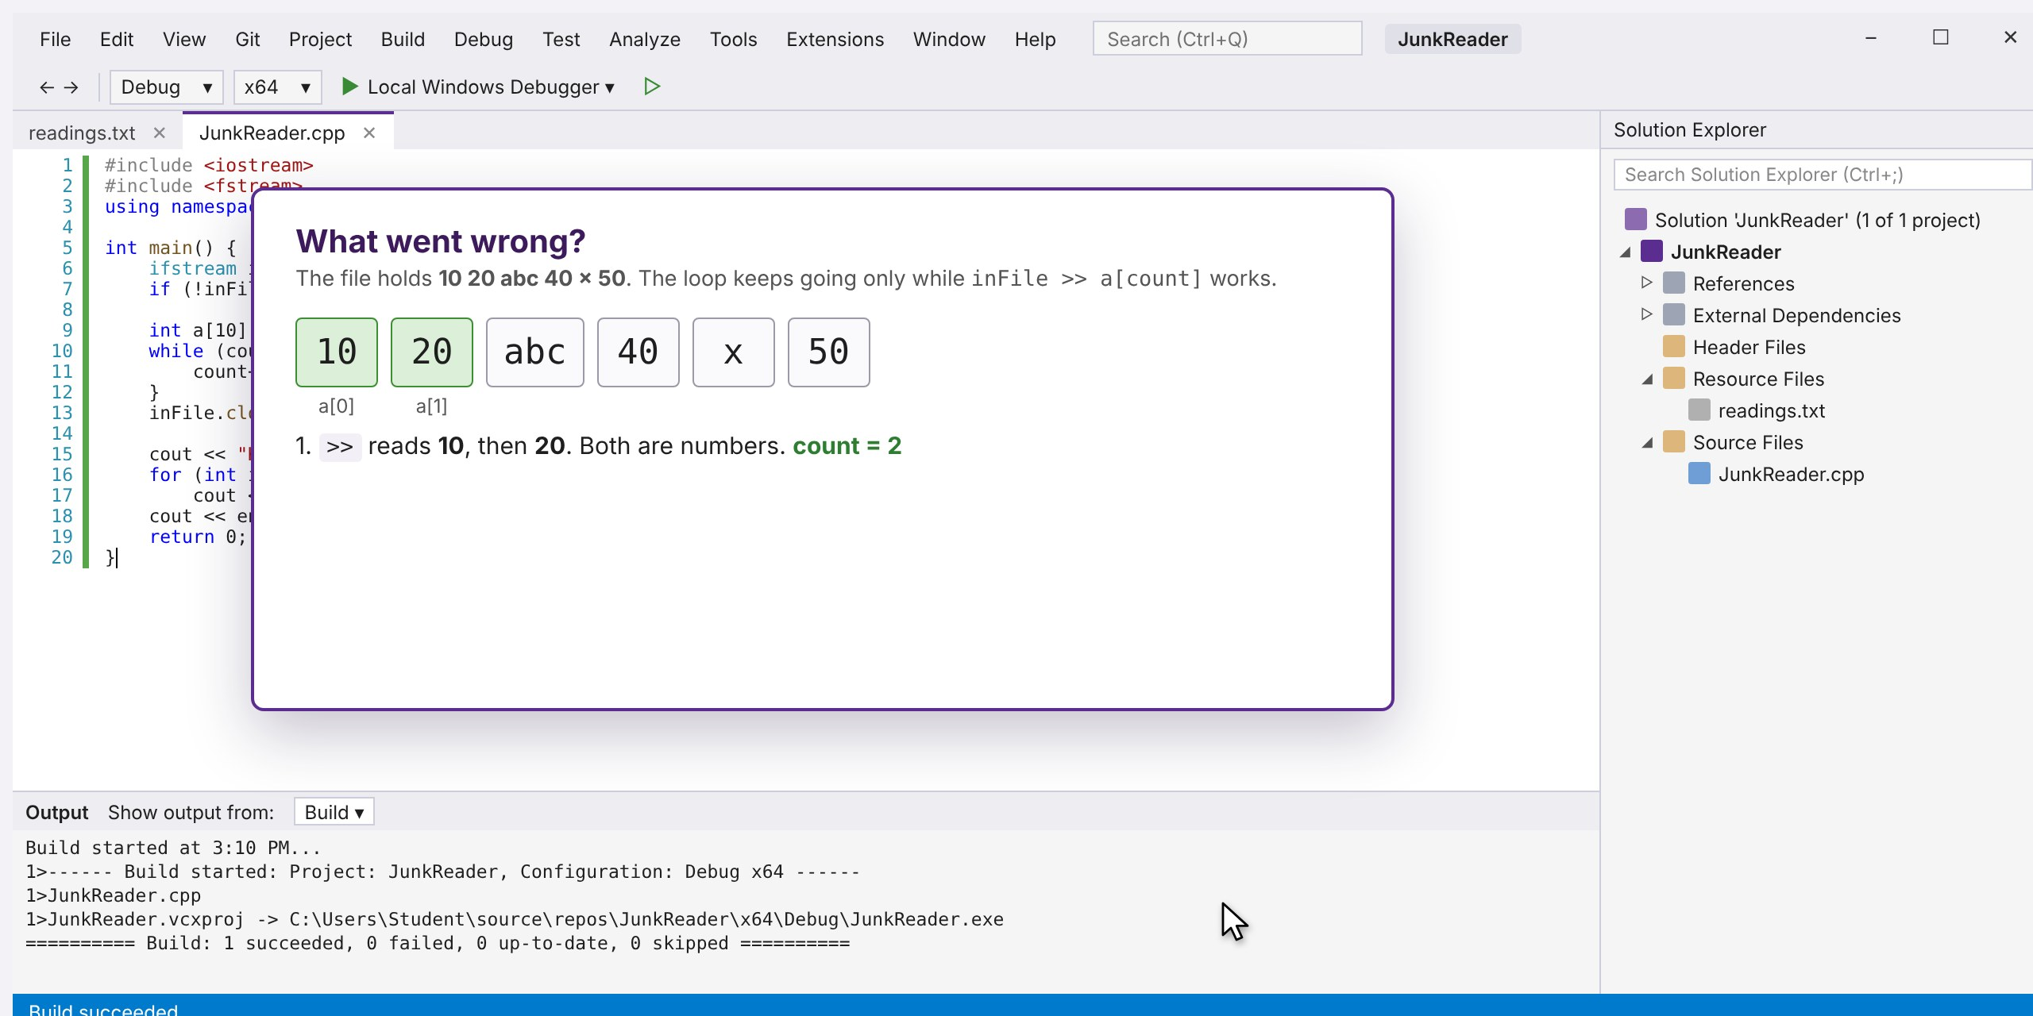
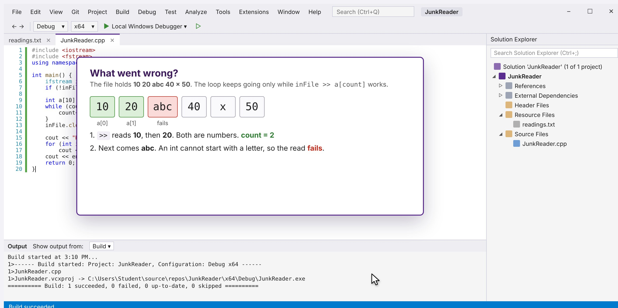
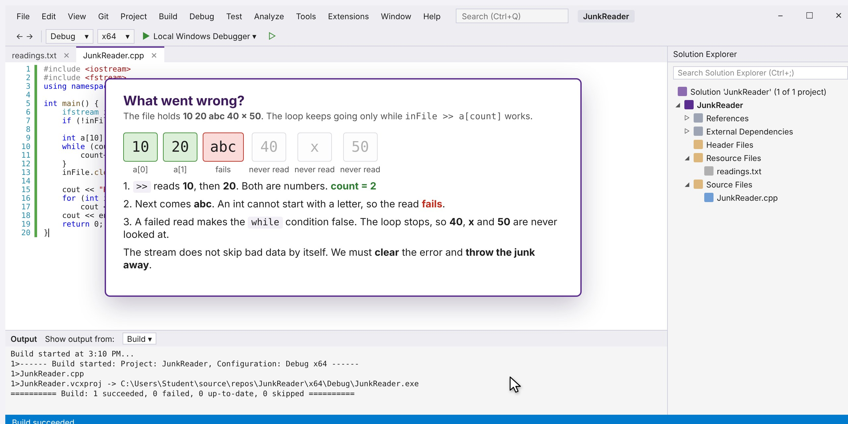
Find the error
STEP 6 OF 11
1
Read 1 and read 2: 10 and 20 are numbers, so both are stored.
2
Read 3 sees the letter a. An int cannot start with a letter, so the read fails.
3
A failed read makes the while condition false, so the loop ends. Everything after abc is ignored.
Tip A failed read puts the stream in a fail state. Every read after that does nothing until clear().
Click to see the next screen
Notes:
1. Read 1 and read 2: 10 and 20 are numbers, so both are stored.
2. Read 3 sees the letter a. An int cannot start with a letter, so the read fails.
3. A failed read makes the while condition false, so the loop ends. Everything after abc is ignored.
Tip: A failed read puts the stream in a fail state. Every read after that does nothing until clear().

Slide 9
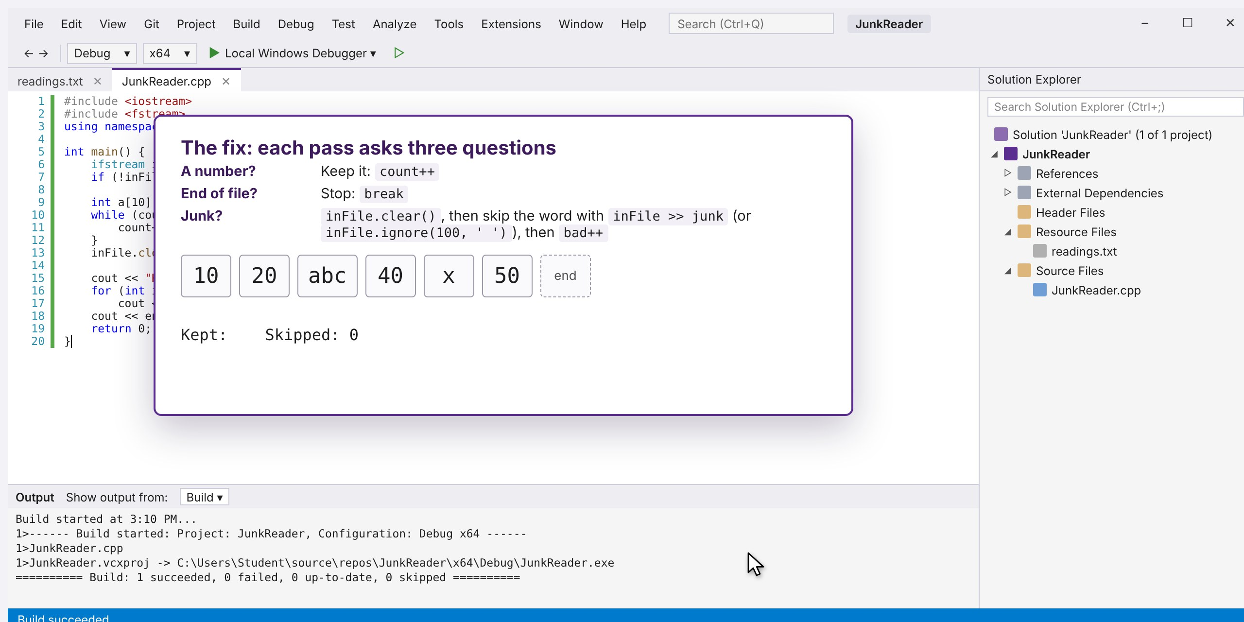
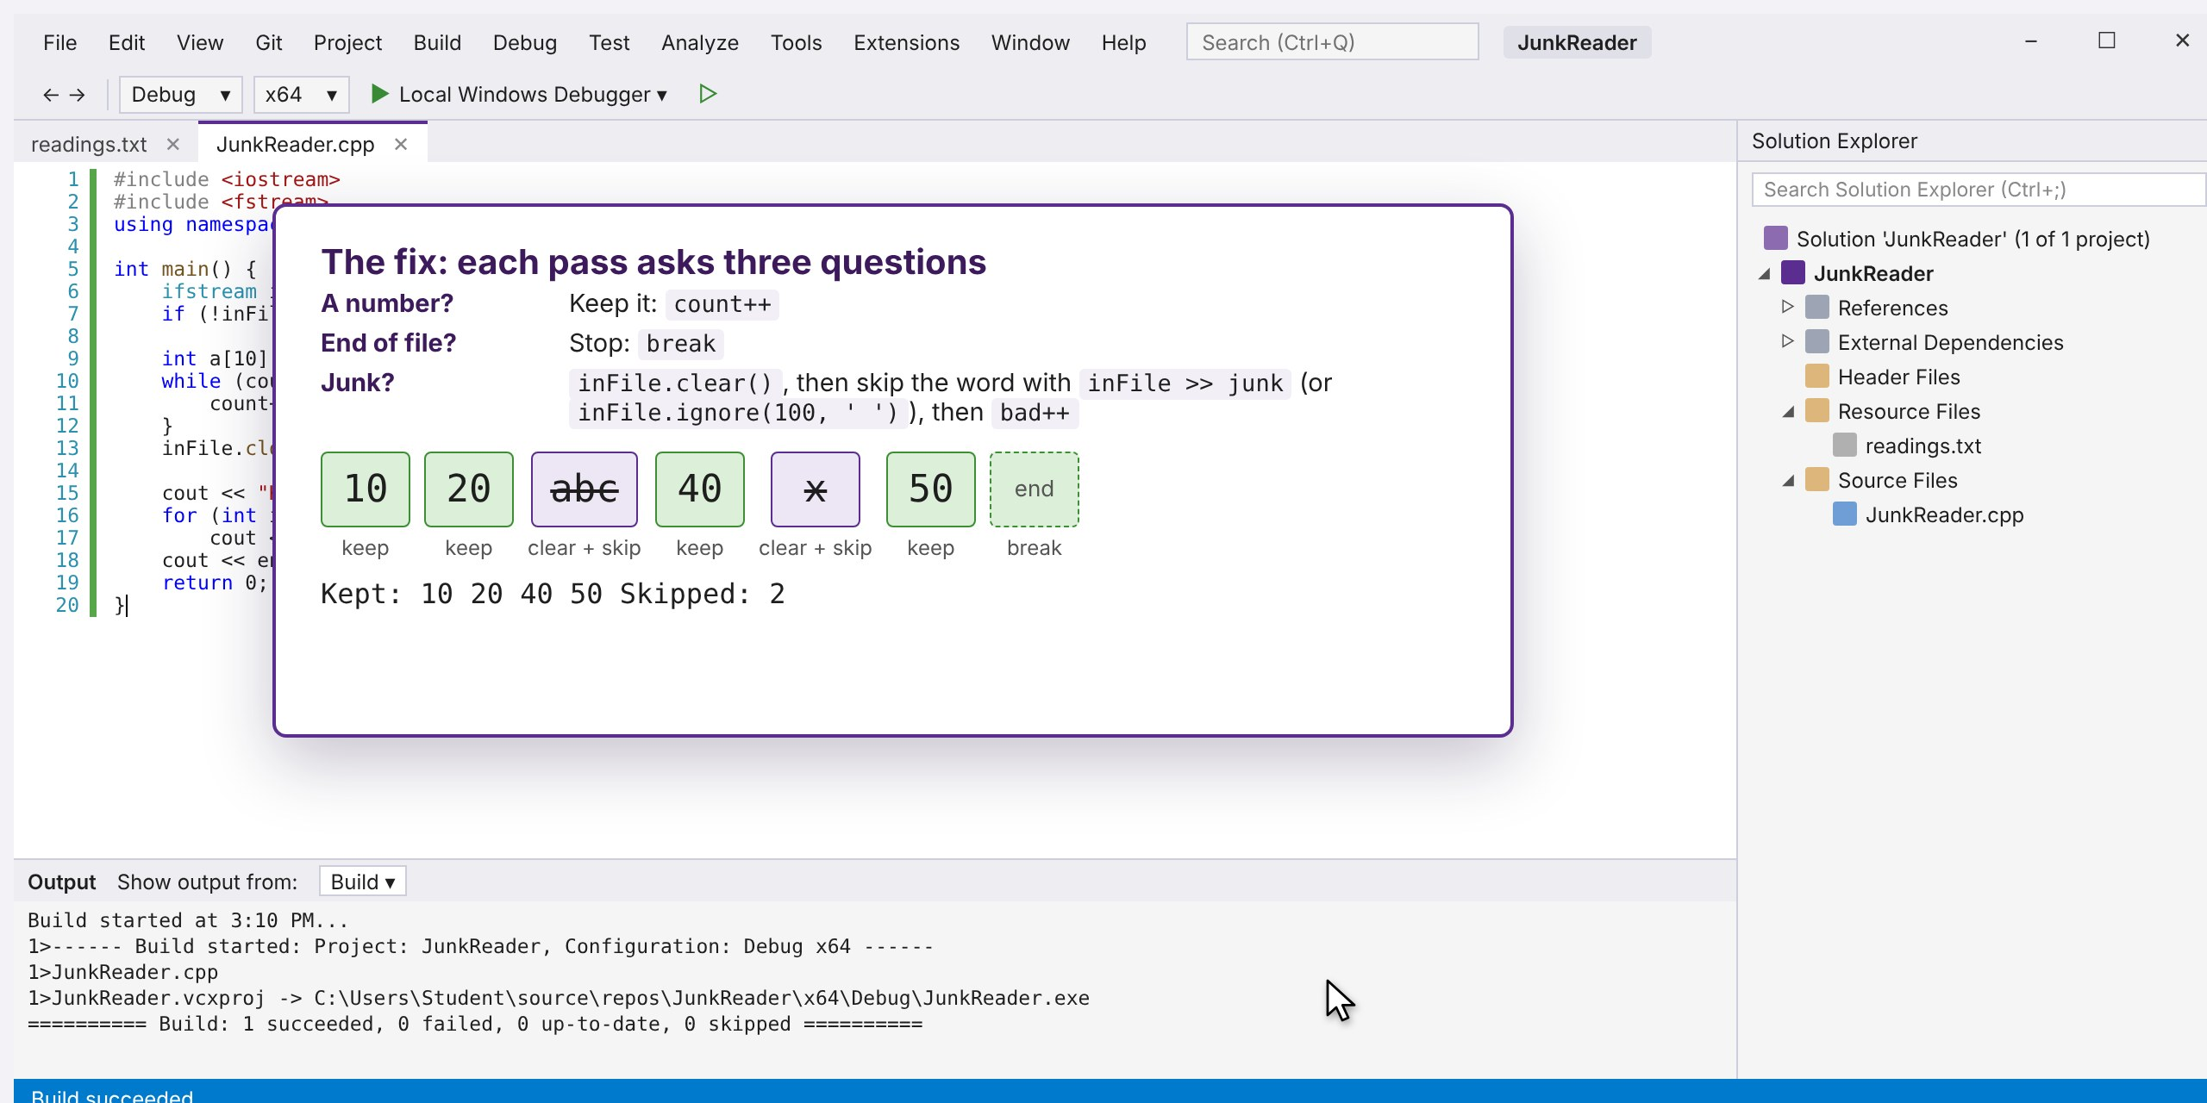
Plan the fix
STEP 7 OF 11
1
New plan: every pass of the loop asks three questions. A number? The end? Or junk?
2
At the end of the file the loop breaks. Result: 10 20 40 50 kept, 2 skipped.
Tip You can skip the junk word with inFile >> junk; or with inFile.ignore(100, ' '); which needs no array.
Click to see the next screen
Notes:
1. New plan: every pass of the loop asks three questions. A number? The end? Or junk?
2. At the end of the file the loop breaks. Result: 10 20 40 50 kept, 2 skipped.
Tip: You can skip the junk word with inFile >> junk; or with inFile.ignore(100, ' '); which needs no array.

Slide 10
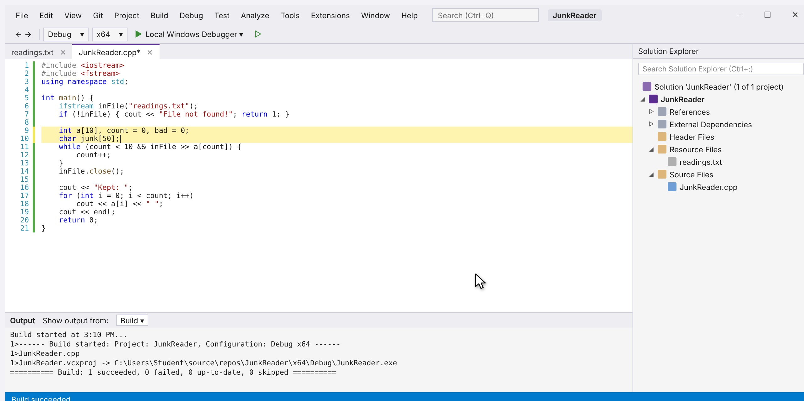
Fix step 1: add two variables
STEP 8 OF 11
1
Add bad to count the junk, and char junk[50] to hold a junk word while we skip it.
Tip bad counts the junk words. junk[50] is a place to put a junk word while skipping it.
Notes:
1. Add bad to count the junk, and char junk[50] to hold a junk word while we skip it.
Tip: bad counts the junk words. junk[50] is a place to put a junk word while skipping it.

Slide 11
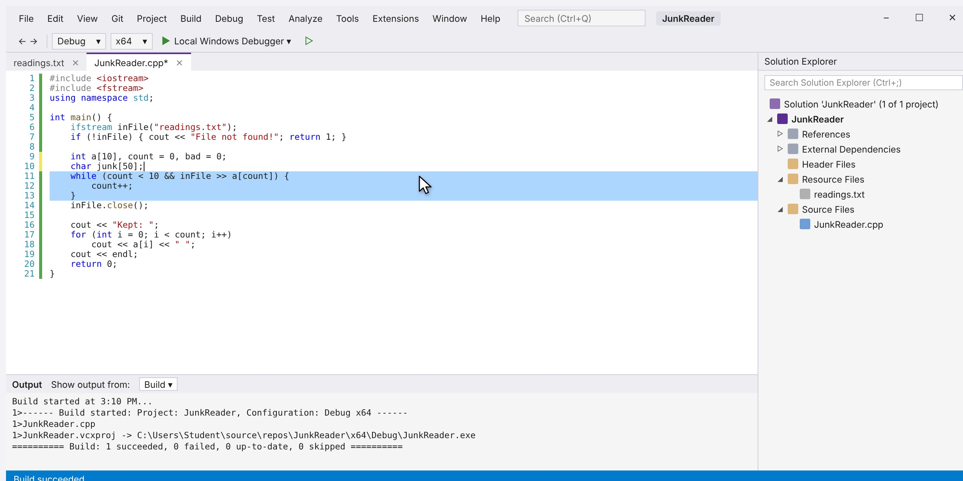
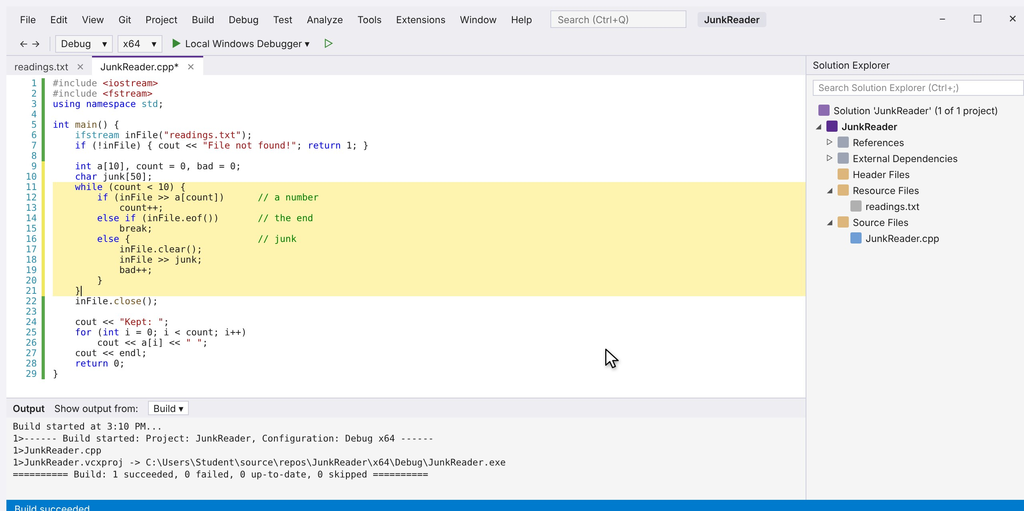
Fix step 2: replace the loop
STEP 9 OF 11
1
Select the old while loop and delete it.
2
Type the new loop: keep numbers, break at the end, and clear() then skip junk.
Tip Order matters: test for a number first, then the end of the file, and only then treat it as junk.
Click to see the next screen
Notes:
1. Select the old while loop and delete it.
2. Type the new loop: keep numbers, break at the end, and clear() then skip junk.
Tip: Order matters: test for a number first, then the end of the file, and only then treat it as junk.

Slide 12
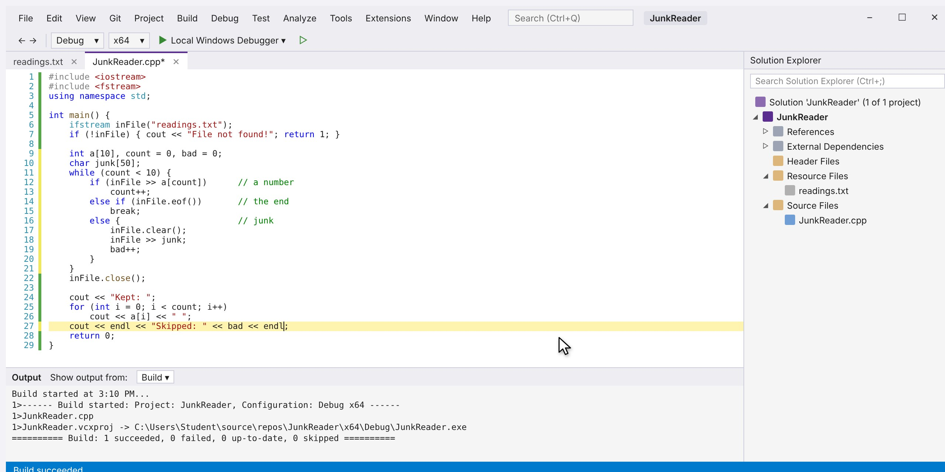
Fix step 3: print the skipped count
STEP 10 OF 11
1
Change the last cout so it also prints how many items were skipped.
Tip Reporting what was skipped tells the user the file had problems, instead of hiding them.
Notes:
1. Change the last cout so it also prints how many items were skipped.
Tip: Reporting what was skipped tells the user the file had problems, instead of hiding them.

Slide 13
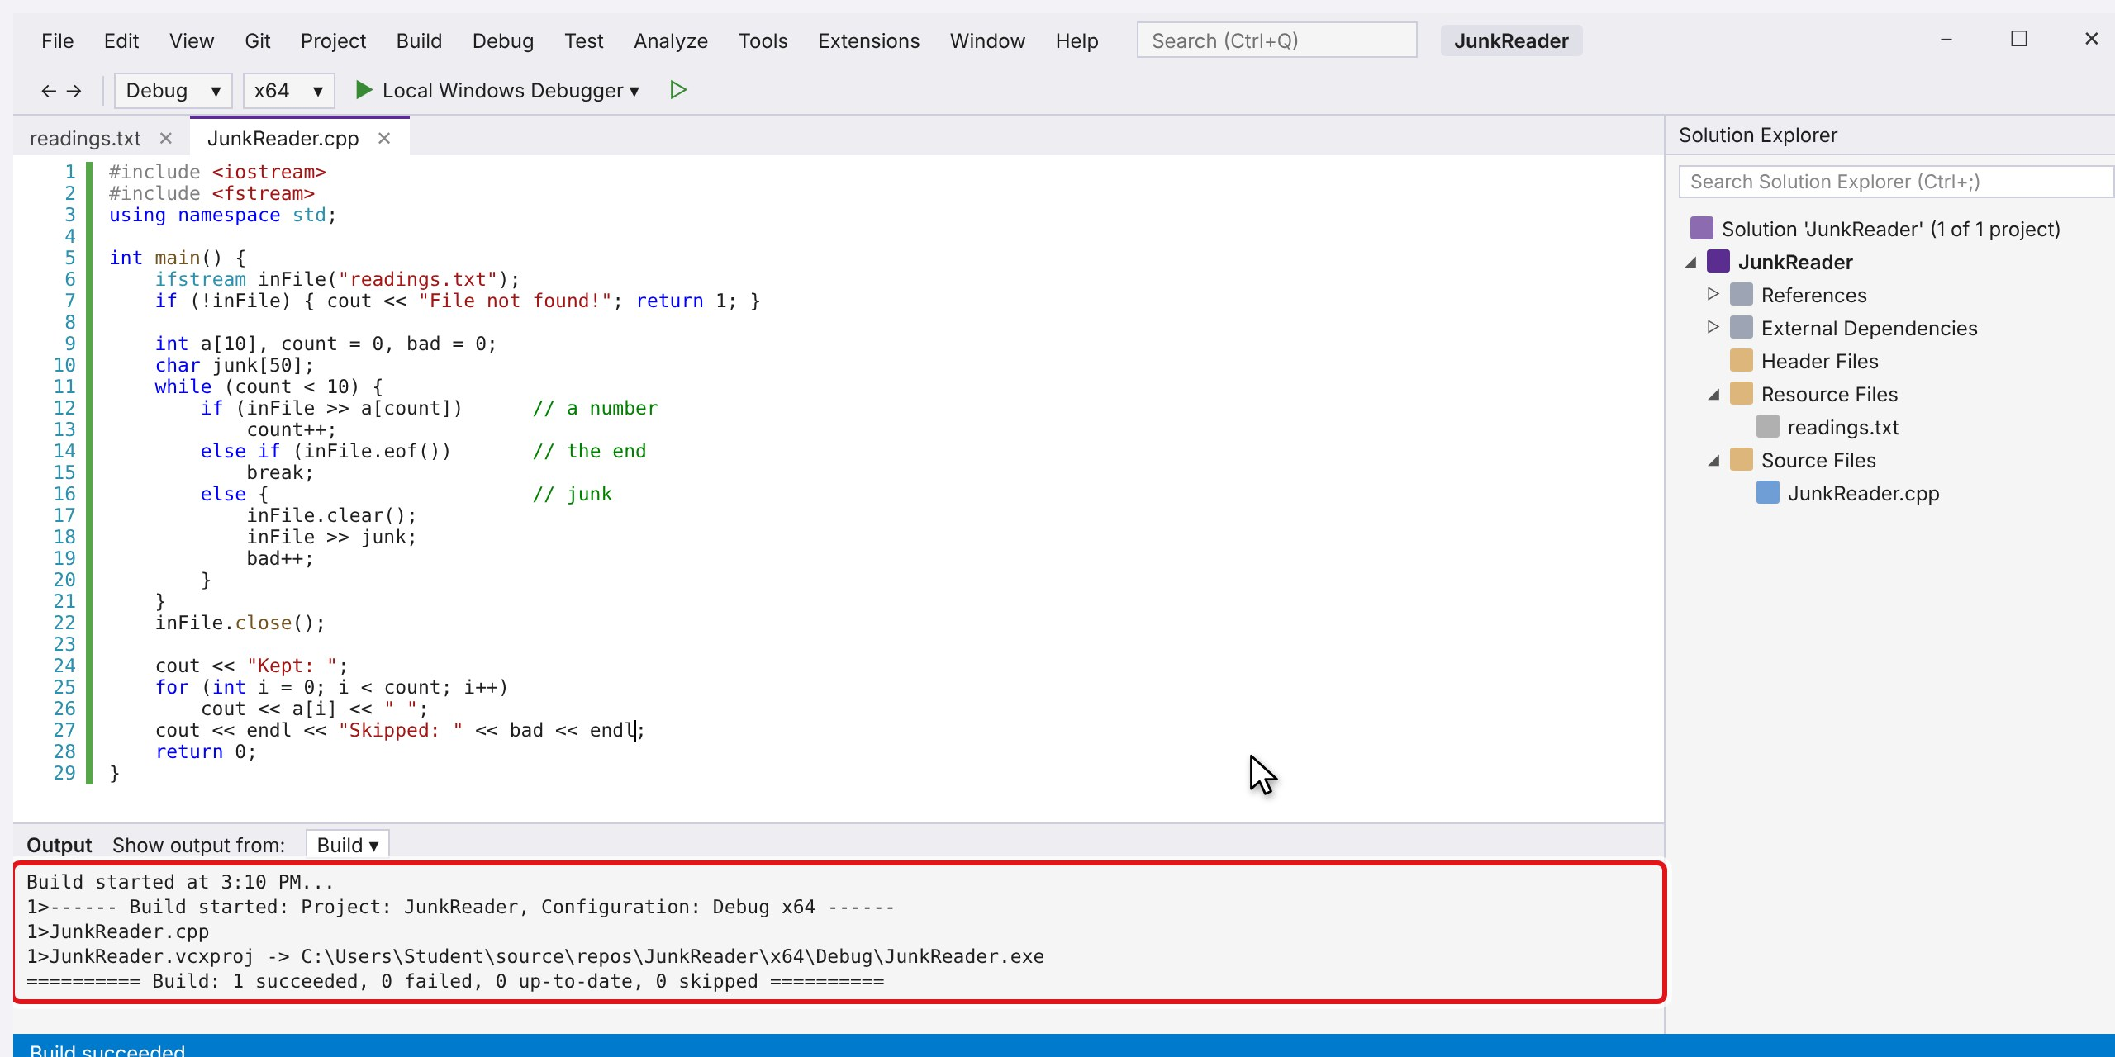
Build and run again
STEP 11 OF 11
1
Press Ctrl+Shift+B to build. The changed lines turn green when the file is saved.
2
Correct! All four numbers are kept and the two junk words are counted.
Tip Try other files: junk at the start (abc 10 20), at the end (10 20 abc), or an empty file.
Click to see the next screen
Notes:
1. Press Ctrl+Shift+B to build. The changed lines turn green when the file is saved.
2. Correct! All four numbers are kept and the two junk words are counted.
Tip: Try other files: junk at the start (abc 10 20), at the end (10 20 abc), or an empty file.

Slide 14
The new loop asks: number, end, or junk?
THE FIX
Before: stops at the first junk word
After: clears and skips the junk
int a[10], count = 0;
while (count < 10 && inFile >> a[count]) {
count++;
}
int a[10], count = 0, bad = 0;
char junk[50];
while (count < 10) {
if (inFile >> a[count]) // a number
count++;
else if (inFile.eof()) // the end
break;
else { // junk
inFile.clear();
inFile >> junk;
bad++;
}
}
Output
Kept: 10 20
Or skip the junk without an array: inFile.clear(); inFile.ignore(100, ' ');
Output
Kept: 10 20 40 50
Skipped: 2
Notes:
Compare the two loops. The old one stops at the first failed read. The new one decides what to do on every pass: keep a number, stop at the end, or clear the stream and skip the junk word. ignore(100, ' ') skips up to the next space and does not need the junk array.

Slide 15
JunkReader.cpp, complete and working
THE FINISHED PROGRAM
#include <iostream>
#include <fstream>
using namespace std;
int main() {
ifstream inFile("readings.txt");
if (!inFile) { cout << "File not found!"; return 1; }
int a[10], count = 0, bad = 0;
char junk[50];
while (count < 10) {
if (inFile >> a[count]) // a number
count++;
else if (inFile.eof()) // the end
break;
else { // junk
inFile.clear();
inFile >> junk;
bad++;
}
}
inFile.close();
cout << "Kept: ";
for (int i = 0; i < count; i++)
cout << a[i] << " ";
cout << endl << "Skipped: " << bad << endl;
return 0;
}
readings.txt
10 20 abc 40 x 50
Output
Kept: 10 20 40 50
Skipped: 2
Save readings.txt in the project folder, next to JunkReader.cpp. Build with Ctrl+Shift+B, run with Ctrl+F5.
Notes:
Hand this slide out as the reference program. The purple lines are the fix from steps 8 to 10.

Slide 16
Watch the whole process
ANIMATION
Notes:
Click the video to play it. It runs about two and a half minutes and covers every step, with captions at the bottom.

